Slide 1


NAME | TEAM MEMBERS | REG.NO
P. Venkata Kishore |  | 2010030569
A. Sai Pranay |  | 2010030467
S. Padmashree |  | 2010030508
G. Pavan Reddy |  | 2010030501
Guided by:-
Dr. Arpitha Guptha

Slide 2


CONTENT
Key Topics
Introduction Problem Statement Motivation Objectives Literature Survey Dataset Techniques & model References Conclusion
OLC | Fundraising Guide

Slide 3
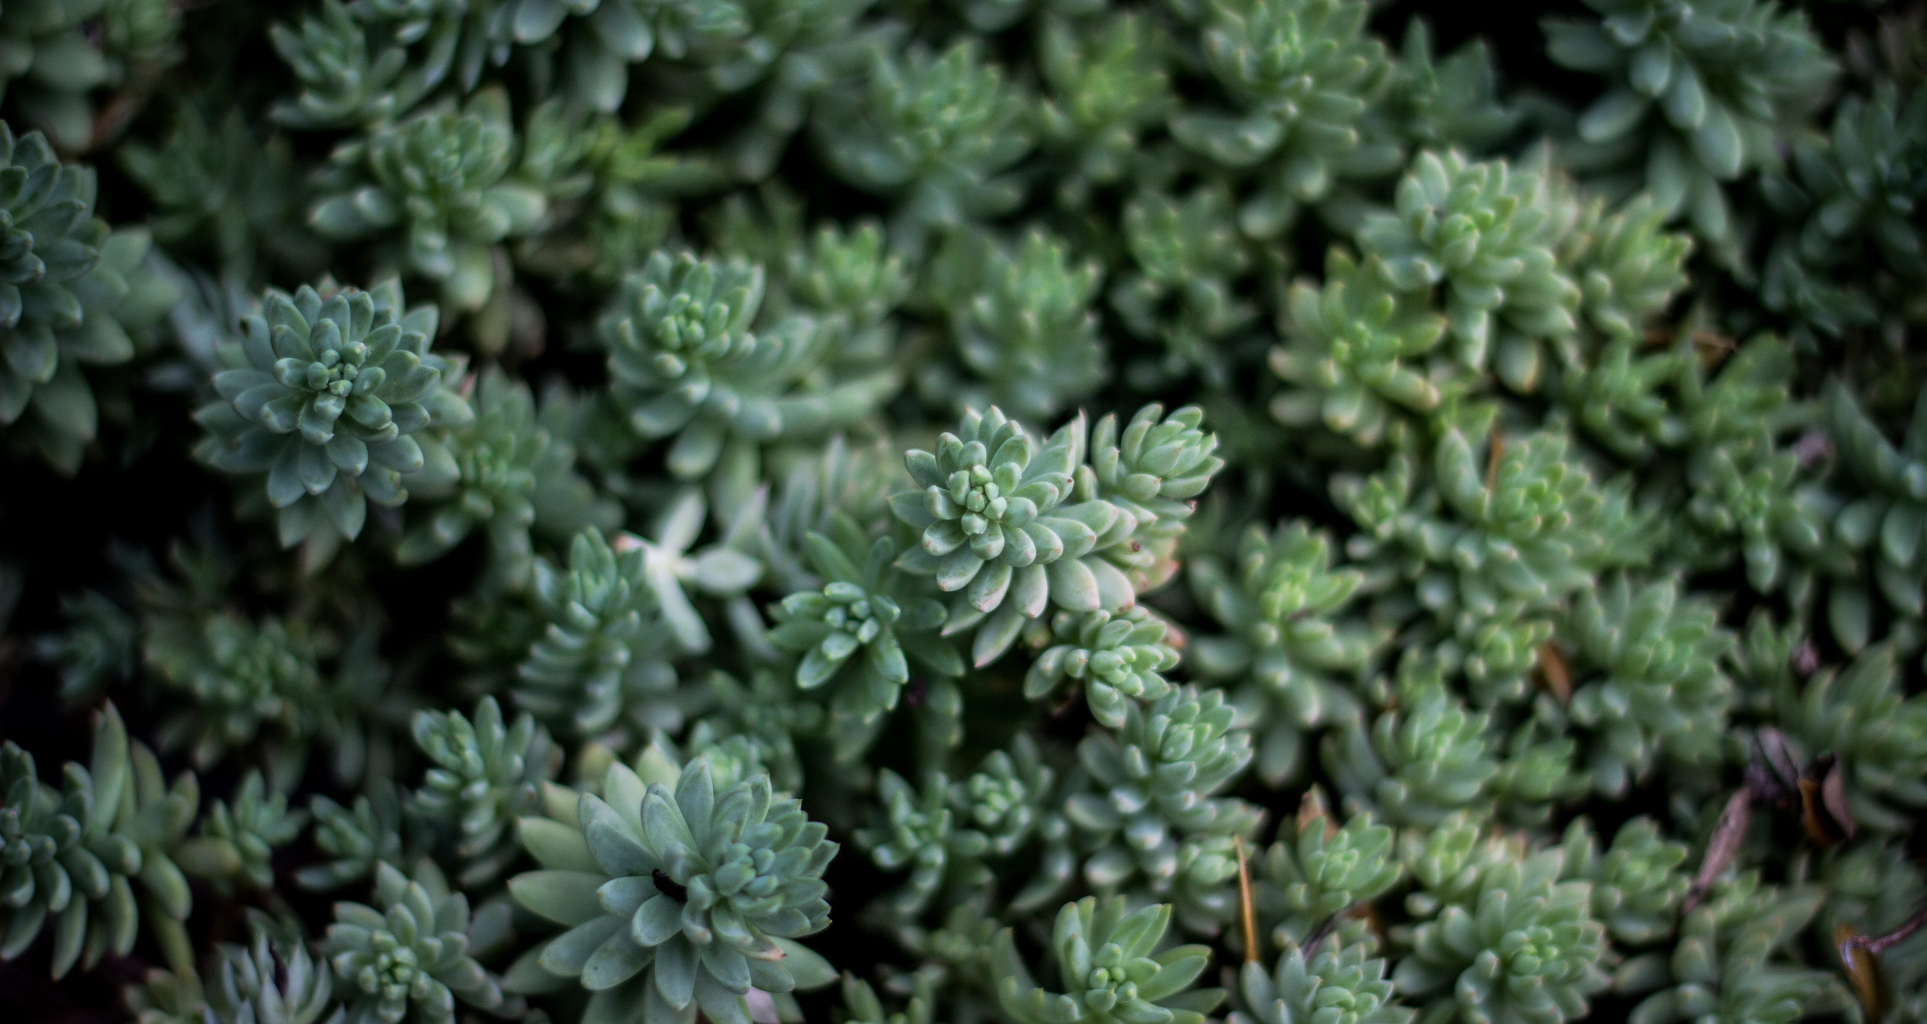

INTRODUCTION
All About Our Project
In our everyday life we used to see a lot of plants and flower. But in most case we have no knowledge about that plants and flower.
Even we don’t know its name. In that case we choose this idea to research and develop our project. Our developed application recognizes the plant in real time by using mobile camera. This project is an attempt at using the concepts ofneural networks to create animage classifier by TensorFlow. Convolutional neural networks are a popular realm of machine learning, and are widely used in image classification. So that we choose this topic to research about image classification by CNN and TensorFlow

Slide 4
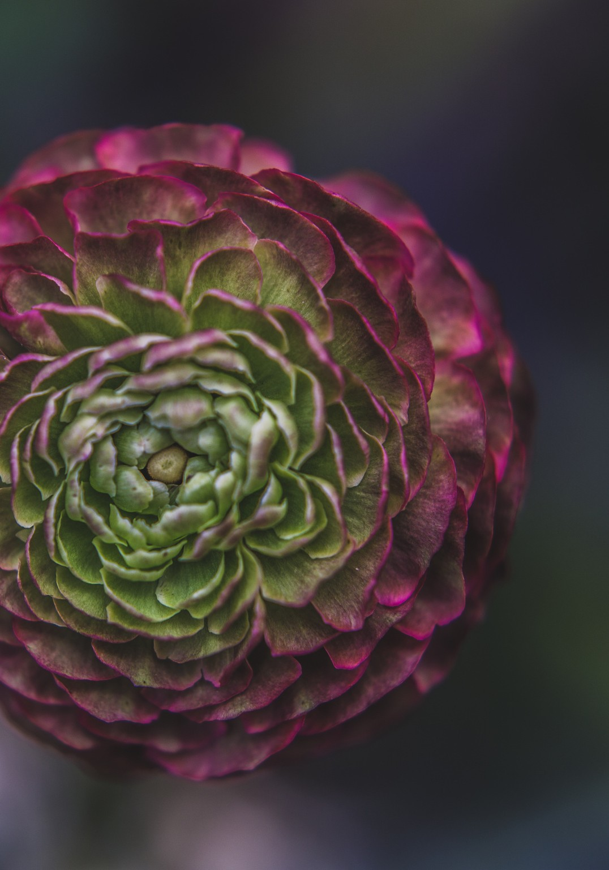
PROBLEM
STATEMENT
Our domain is Computer Vision and sub domain is Image Classification.Our problem statement is to detect plant by digital image processing . By this project of plant detection, we can detect which plant it is, what are the requirements, any disease just by clicking a photo of that plant, we can come to know all the details about that plant. This will be a faster detecting process, so that every person can know easily know about a plant and there requirement

Slide 5


MOTIVATIONS
The detection of the type of plant and identification of the diseases and requirements for the plant is necessary in improving agriculture or in the growth of a particular plant.
This process will be slow by doing in the physical techiniques,we need the experts help sometimes it will be error prone and who are less available. If these quality methods are recorded into automatic system by using appropriate program design language then the effort will be error free and faster.

Slide 6
The First Objective
The main objective of this is to detect the plant and help to detect specific type and disease and requirement of the given plant and help the Users.
The Second Objective
The Plants or crops are growed in the soil, monitoring the stages of growth is also essential to optimizing production efficiency. It’s vital to understand interactions between crop growth and the soil in order to make adjustments for improved crop health.
Objectives
The Third Objective
TheLeaves of a plant can be used to determine the health status of that plant. The objective of this work is to develop a system that capable to detect and identify the type of disease

Slide 7
Literature Survey
S.NO | TITLE | Author | Published on | Pro’s | Con’s
1 | Image Processing Technique for the Detection of Alberseem Leaves Diseases Based on Soft Computing | Eimad Abdu Abusham | April , 2021 | The SVM-Support Vector Machine Classifier techniques is used in this Prediction accuracy is high and having robust working when training example have error in them. | This techniques Require long training time
2 | A Hybrid Approach for Plant Leaf Disease Detection and Classification Using Digital Image Processing Methods | Anusha Rao , S.B. Kulkarni | October 4, 2020 | It is easy to implement and gives quick result. | Slow learner and fully not robust to the noise data in large training.
3 | Image Processing Methods in Agricultural Observation Systems | Chen Zhang , Li Lin | 13 April 2021 | It will help to sustaining the needs of today world by image processing | It requires good online datasets to get access to it
4 | PLANT LEAF DISEASE IDENTIFICATION USING IMAGE PROCESSING AND SVM, ANN CLASSIFIER METHODS | S.Sivasakthi | May , 2020 | The ANN techniques have Good potential with ability to detect plant leaf disease. | It Require more time
5 | Plant diseases and pests detection based on deep learning | Jun Liu , Xuewei Wang | 24 February 2021 | It is an upcoming method which have good potential | It requires more time to implement

Slide 8
Dataset
DATASETS | CHRACTERISTIC | REFERENCE LINK
PlantVillage | It is a dataset that contains roughly 54,000 plant leaf picture | https://www.kaggle.com/abdallahalidev/plantvillage-dataset
PlantDoc | This dataset contains the details about plant diseases and different image | https://github.com/pratikkayal/PlantDoc-Dataset
Edible wild plant | This dataset contain 62 edible wild plant Images | https://www.kaggle.com/gverzea/edible-wild-plants
Ornamental plants | This dataset contain 500 Images of Flower | https://www.kaggle.com/abdalnassir/ornamental-plants

Slide 9






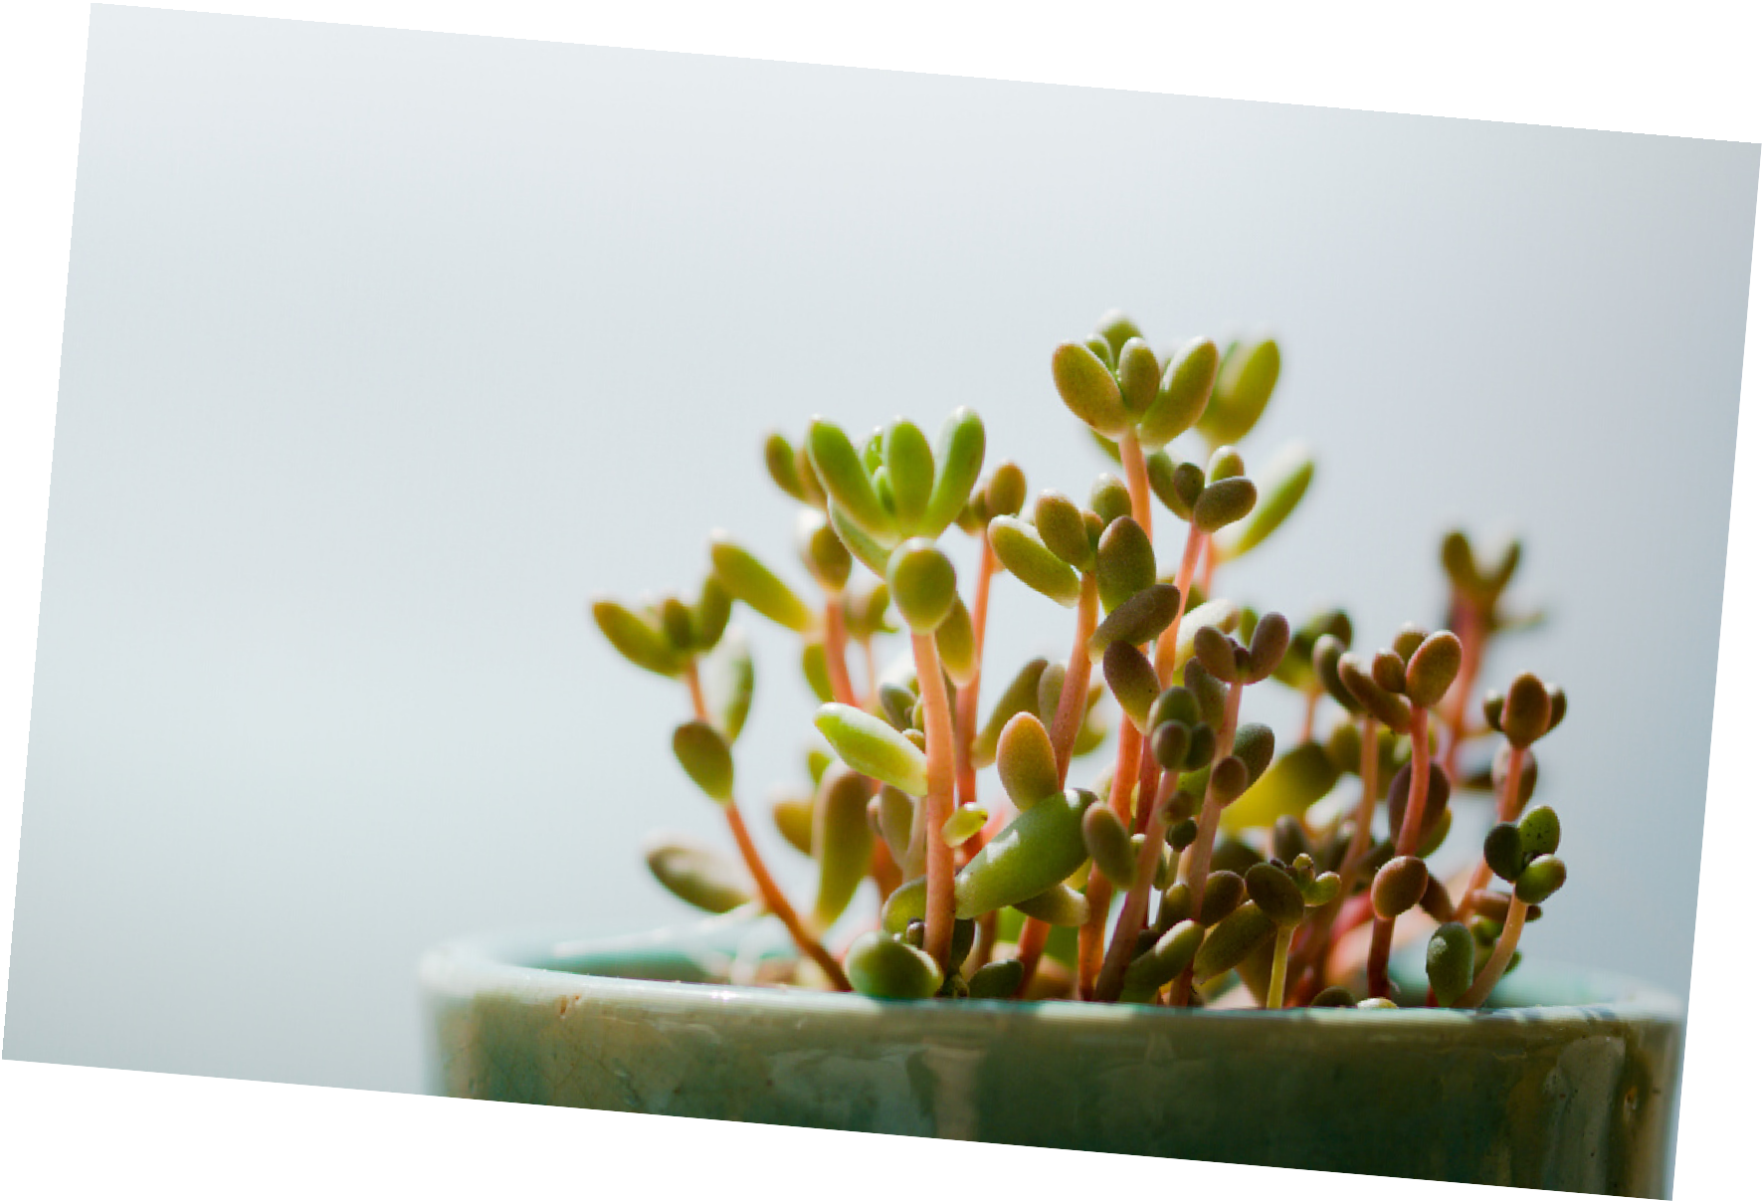
Techniques & MODELS
1. ResnetV2 - It Is a neural network architecture used for image classification, regression and feature extraction. It uses skip connections to add the input of a group of convolutions to its output.
2. MobileNet- It is a type of convolutional neural network designed for mobile and embedded vision applications. They are based on a streamlined architecture that uses depth wise separable convolutions to build lightweight deep neural networks that can have low latency for mobile and embedded devices.
3. Resnet50 – It is a convolutional neural network that is 50 layers deep. You can load a pretrained version of the network trained on more than a million images from the ImageNet database
4. CNN Model- It is a type of neural network model which allows us to extract higher representations for the image content.
5. Data Augmentation- It generate different versions of a real dataset artificially to increase its size.
6. image segmentation- It is the process by which a digital image is partitioned into various subgroups (of pixels) called Image Objects, which can reduce the complexity of the image, and thus analyzing the image becomes simpler.
Jade
Plant

Slide 10
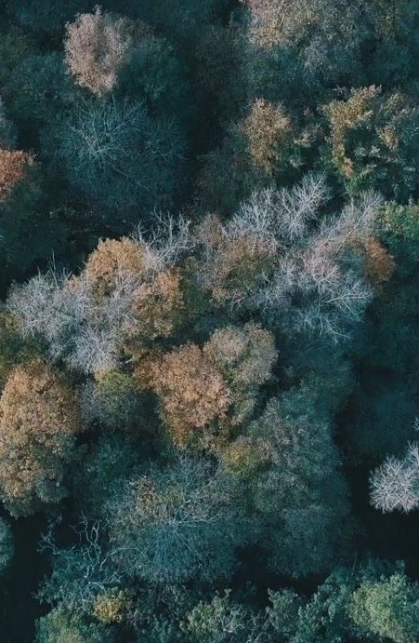
References
PLANT LEAF DISEASE IDENTIFICATION USING IMAGE PROCESSIN AND SVM,ANN CLASSIFIER METHODS
HTTP:// WWW. IJACONLINE. COM/ WPCONTENT/ UPLOADS/ 2020 / 02 / LEAF- 1 . PDF
IMAGE PROCESSING TECHNIQUE FOR THE DETECTION OF ALBERSEEM LEAVES DISEASES BASED ON SOFT COMPUTING
https://acaap.com/index.php/airdj/article/view/27
A HYBRID APPROACH FOR PLANT LEAF DISEASE DETECTION AND CLASSIFICATION USING DIGITAL IMAGE PROCESSING METHODS
https://journals.sagepub.com/doi/abs/10.1177/0020720920953126
IMAGE PROCESSING METHODS IN AGRICULTURAL OBSERVATION SYSTEMS
https://link.springer.com/chapter/10.1007/978-3-030-66387-2_6

Slide 11

CONCLUSION
our project is all about identification of plants and their details .Our developed application recognizes the plant in real time by using mobile camera. and we can explore plants around the world

Slide 12


